Slide 1
Linear Regression sample Effect on sales from advertisement spending

Slide 2
Preliminary Information
Advertising_Data.csv contains 4 fields, Sales, Newspaper, Radio, and TV.
Each field represents how much was spent in that medium in thousands of dollars in a particular market
Sales represents how much of the product was sold

Slide 3
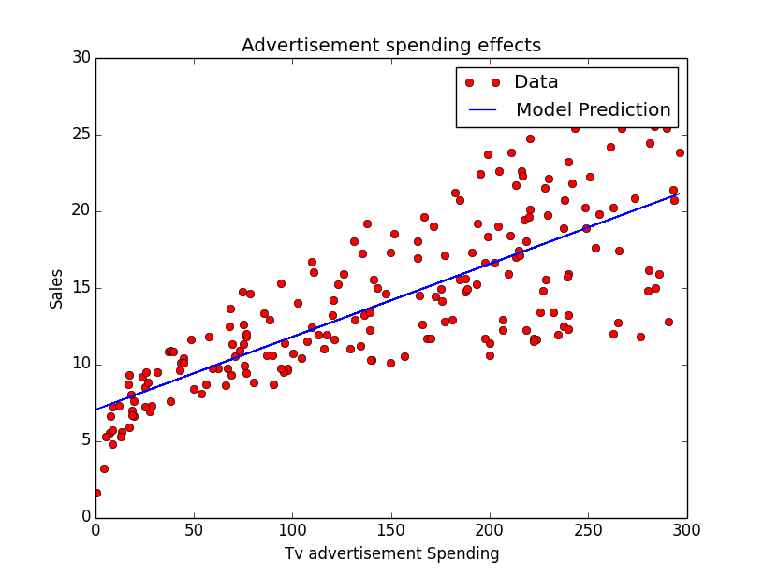
Regression of Sales on TV
TV coefficient p-value < .05
R-Squared = .612
Residual Standard Error = 5.3

Slide 4
There is clearly some systemic error as the error terms increase as TV spending increases, this suggests a non linear relationship
For regressing on a single variable it does a decent enough job
For now lets add another predictor to try and get a better fit

Slide 5
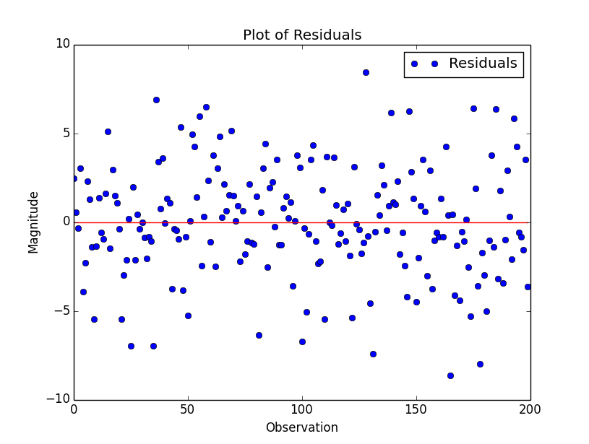
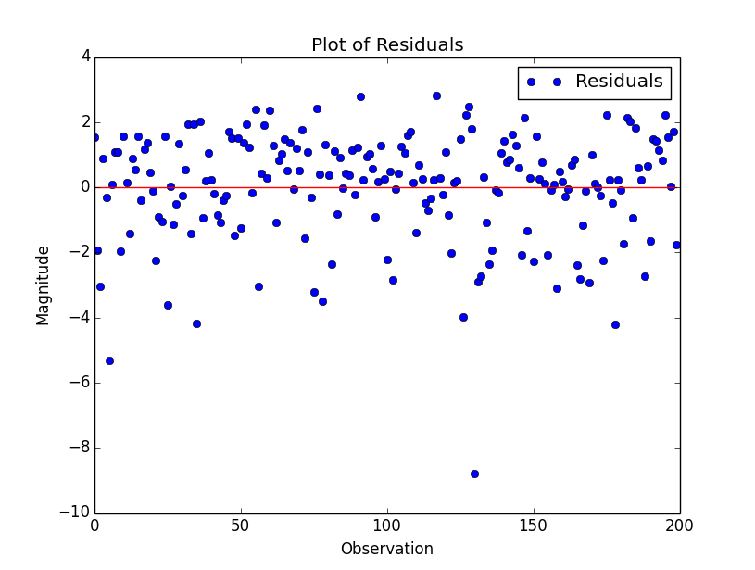
Regression of Sales on TV + Newspaper & Regression of Sales on TV + Radio
TV + Newspaper
Coefficient p-values < .05
R-Squared = .64
RSE = 4.8
TV + Radio
Coefficient p-values < .05
R-Squared = .897
RSE = 1.4

Slide 6
Adding Newspaper improves R-squared and lowers RSE slightly, a strong indicator that it should be left out of the model
Adding Radio increases R-squared dramatically as well as lowering the RSE. A good candidate for keeping in the model.
RSE = Residual Standard Error

Slide 7
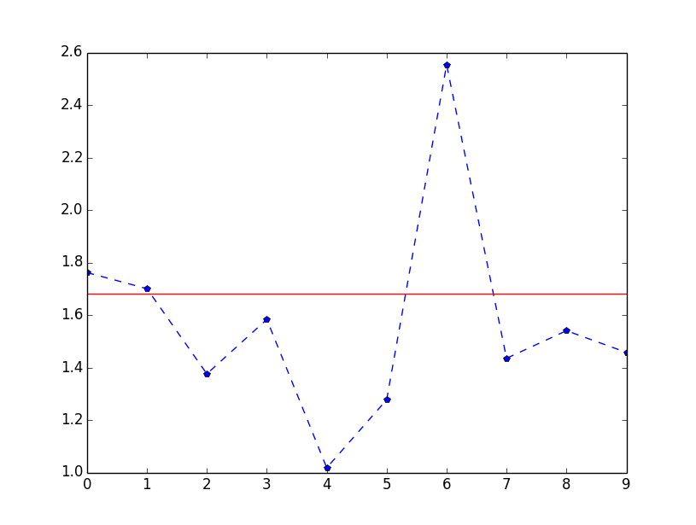
Residual analysis of Sales on TV and Radio
Dividing the residuals into groups of ten and graphing each groups standard error gives the following
The error terms are not of constant magnitude, possibly affecting the accuracy of our estimates
Earlier it seemed that the TV model had a larger error when more was spent on advertising, here we have the same pattern
This is a clue that there could be synergistic pattern, meaning that TV and Radio reinforce each others effect, moving Sales in a non-linear fashion
Red Line = RSE
Blue Dashed Line = SD of residual groups

Slide 8
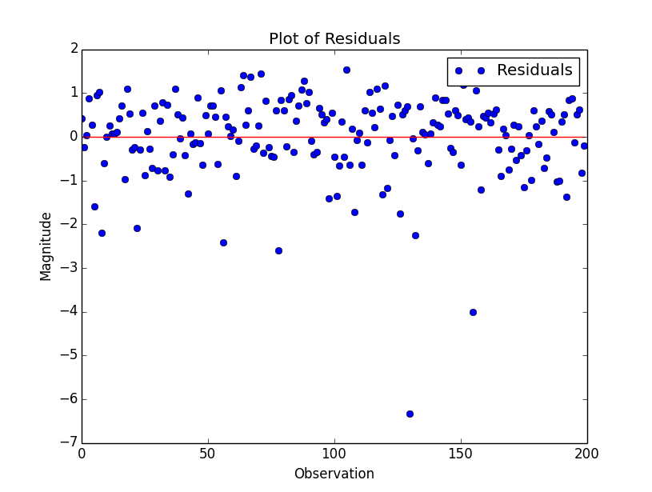
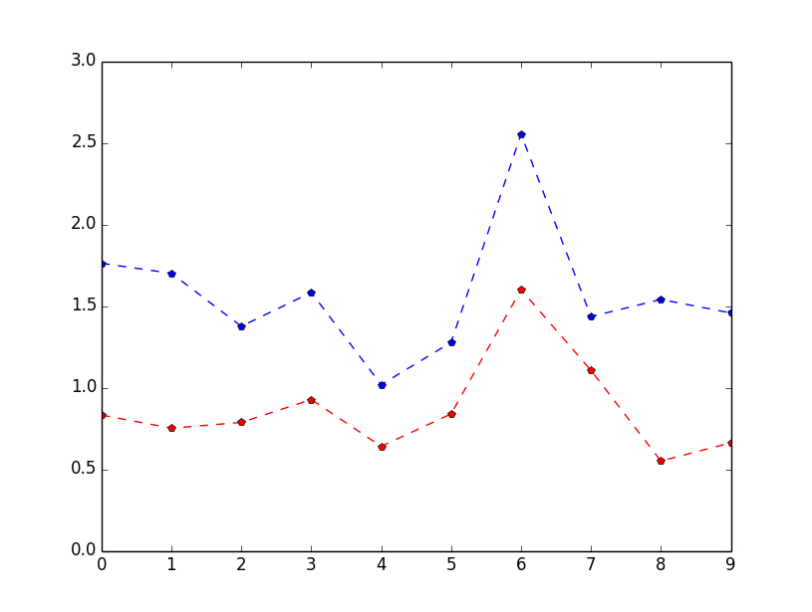
TV + Radio + Interaction Term
R-Squared of .96
Coefficients and model have p-values < .05
RSE of 0.94
By all measures this is the best model out of all that have been tested
Here we can see that the magnitude of the SDs in general has decreased, though there is still a peak at the 7th group due to an outlier
Red Dashed Line = SD of residual groups from TV and Radio and Interaction Term Model
Blue Dashed Line = SD of residual groups from TV and Radio model

Slide 9
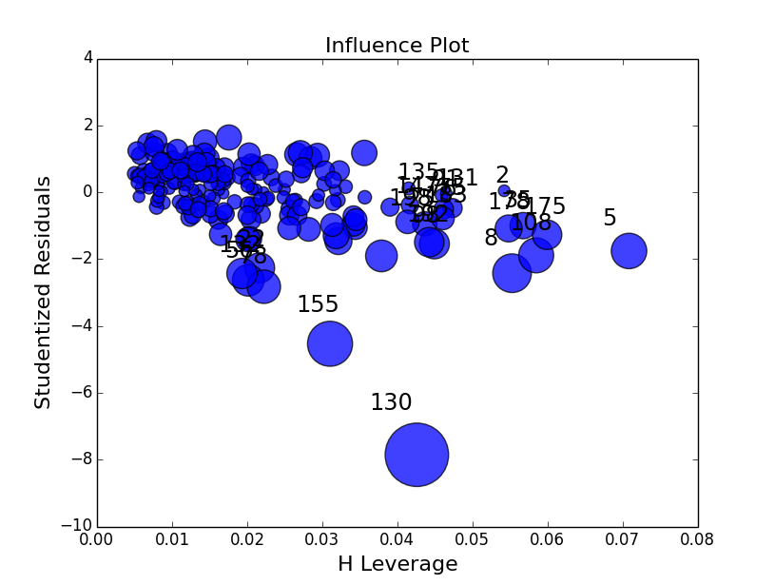
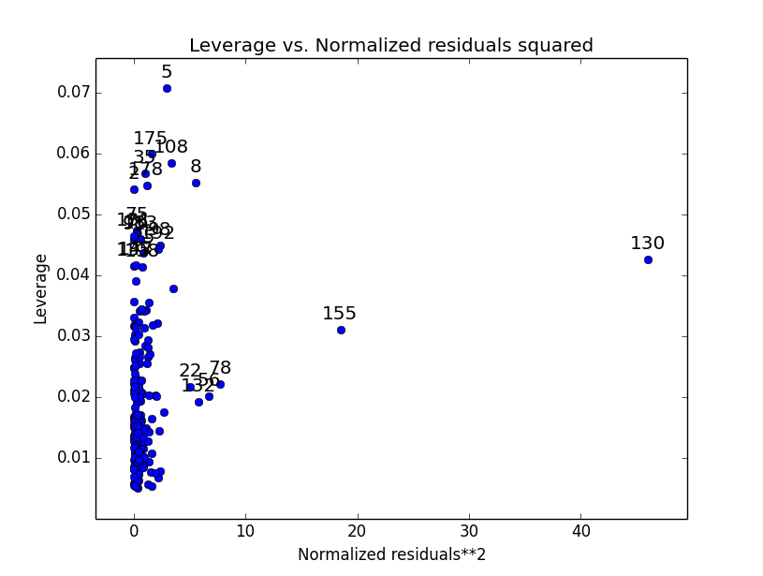
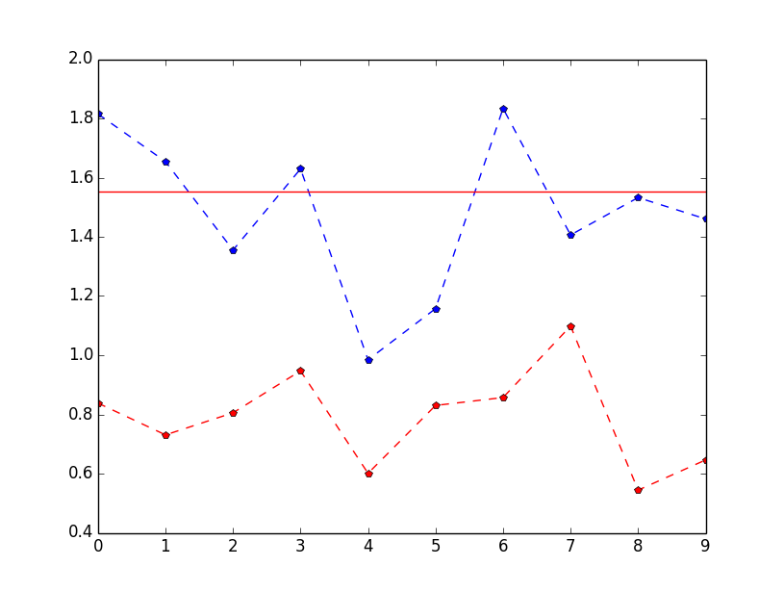
The last bit of work is to remove this outlier, observation 130, which is causing a significant spike in its error term
Now the model has an r-squared of .97 and the coefficient terms have a smaller confidence interval. The error terms are also smaller
Red Dashed Line = SD of residual groups from TV and Radio and Interaction Term Model
Blue Dashed Line = SD of residual groups from TV and Radio model

